Slide 1
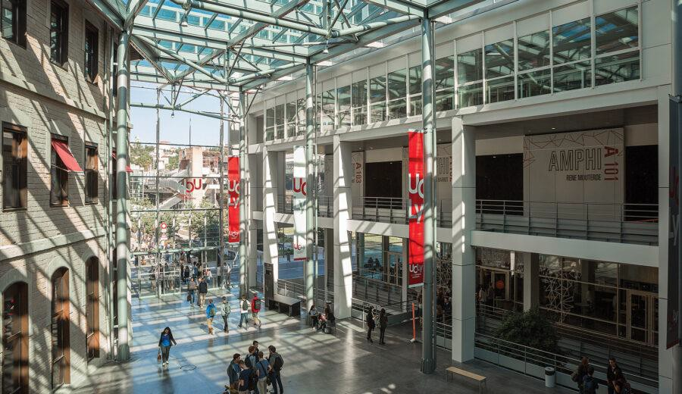
ESDES – Catholic University of Lyon
brand new and centrally-located campus
modern facilities: library, gym, student restaurant, working spaces, music room
Student services
housing services
administrative assistance for health
insurance, student visa processing, course selection
International student’s Club helping integrate foreign students into the “Lyon way of life”.
cultural activities, skiing
https://www.esdes.fr/en/welcome/programs/bachelor-in-business/

Slide 2
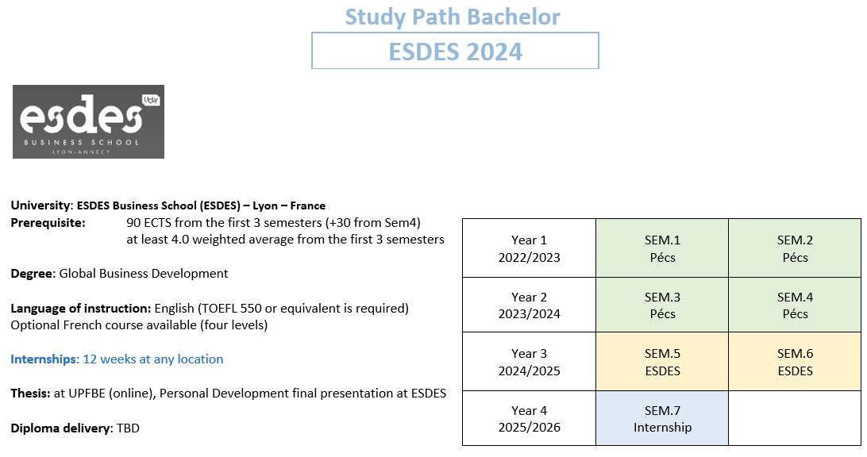

Slide 3

KEDGE Business School
Facilities and services
Library
Housing support
Sports Areas
Business nursery
Cafeteria
Associations
Wellness team
Student Office/ IT support
Week-long welcome session
https://student.kedge.edu/programmes/kedge-bachelor#programmeMenu

Slide 4
