Slide 1



Application for Internship
OpenUP platform
Klaudia Rádóczy
radoczy.klaudia@ktk.pte.hu

Slide 2
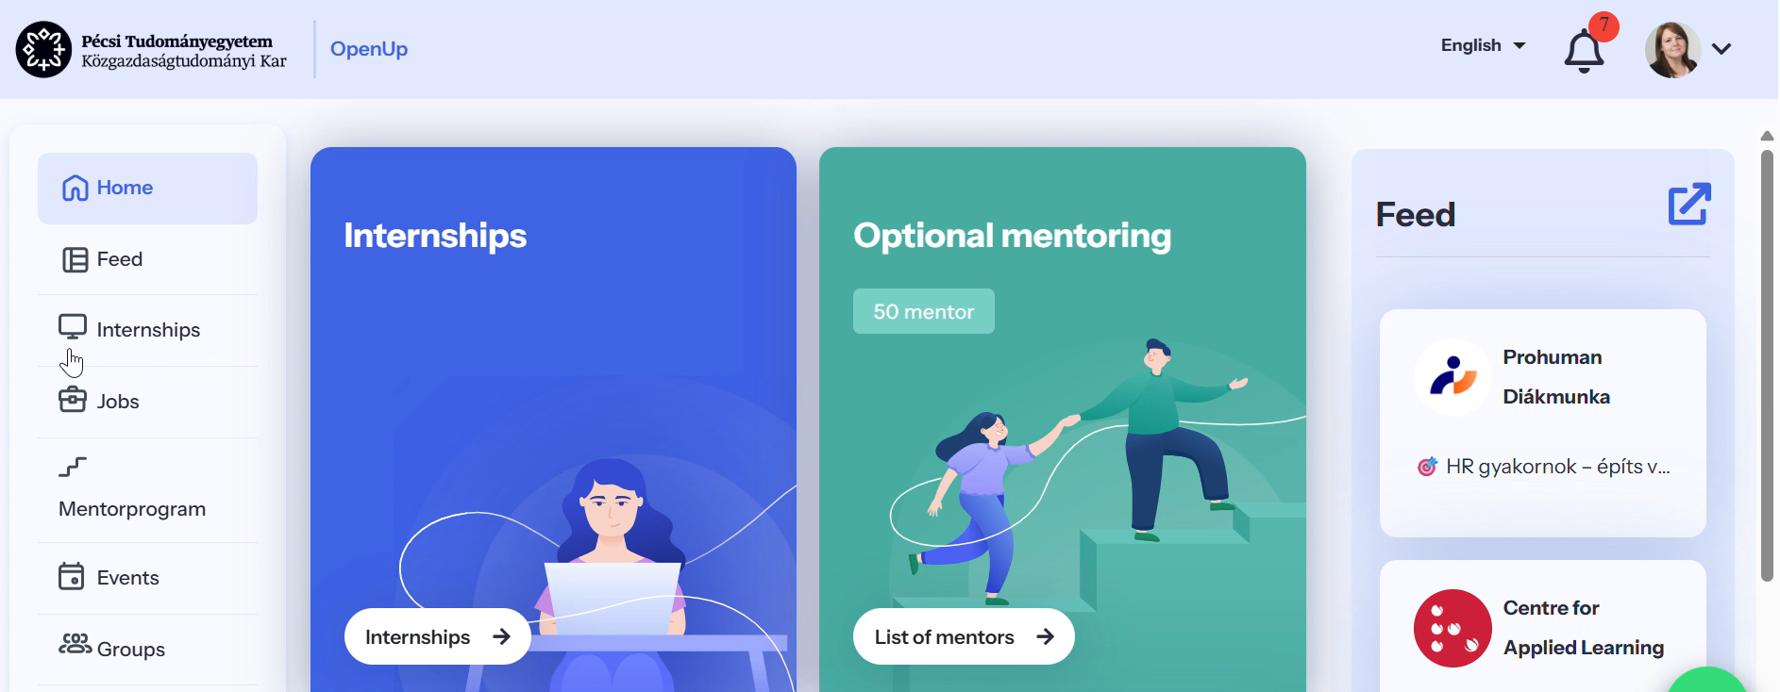
The partner placements available for the current internship period can be found under the “Internship” menu item.

Slide 3
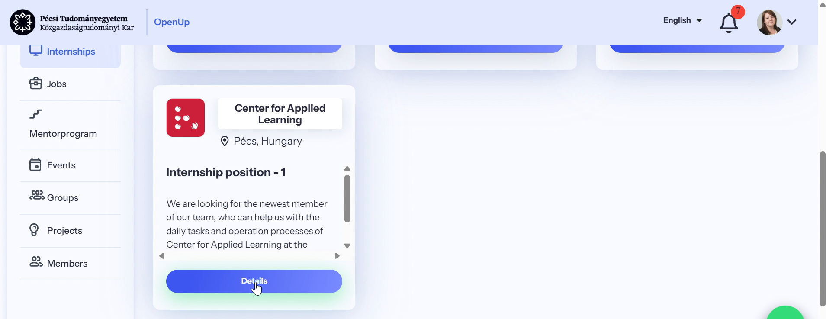
Click the “Details” button to view the full internship description

Slide 4
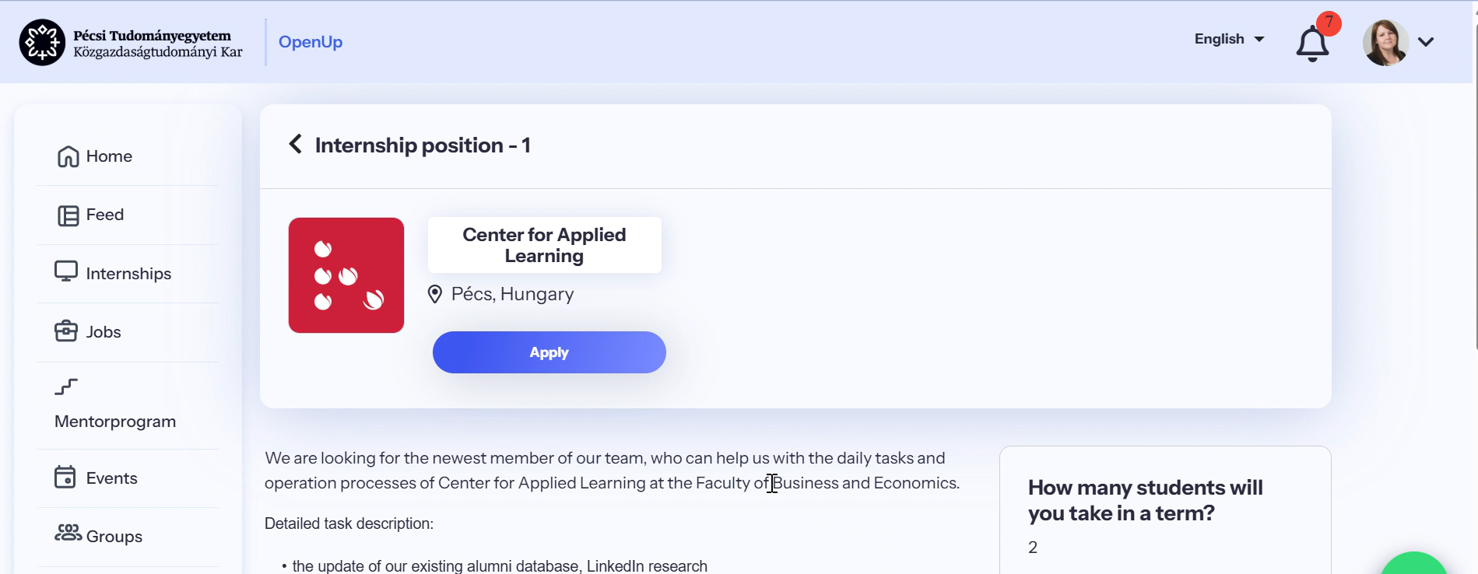
If you are assigned to the current internship period, the “Application” button will appear or become active.

Slide 5
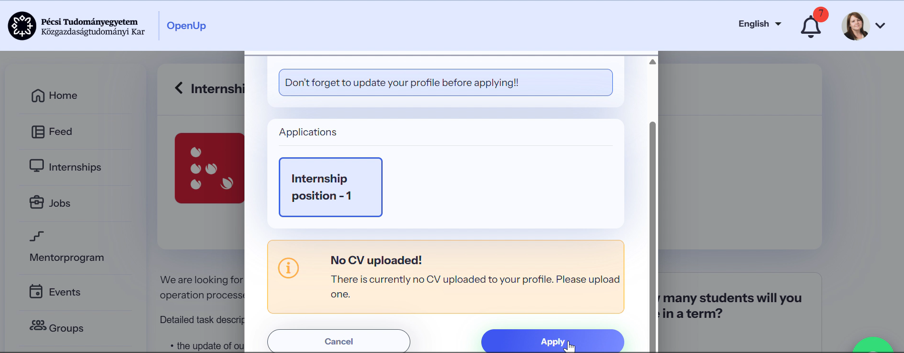
Once your profile has been properly completed and your updated CV uploaded, you can start the application process by clicking the “Application” button.

Slide 6
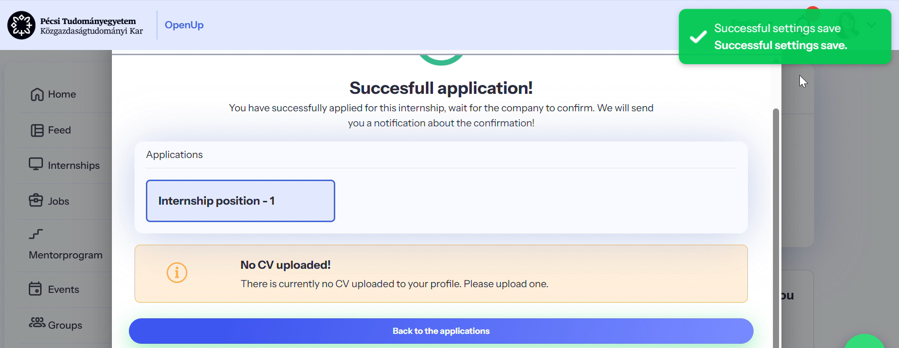
After submitting your application, a system notification will confirm that it has been successfully saved. You can then click “Back to the applications” to go to the “My Applications” page.

Slide 7
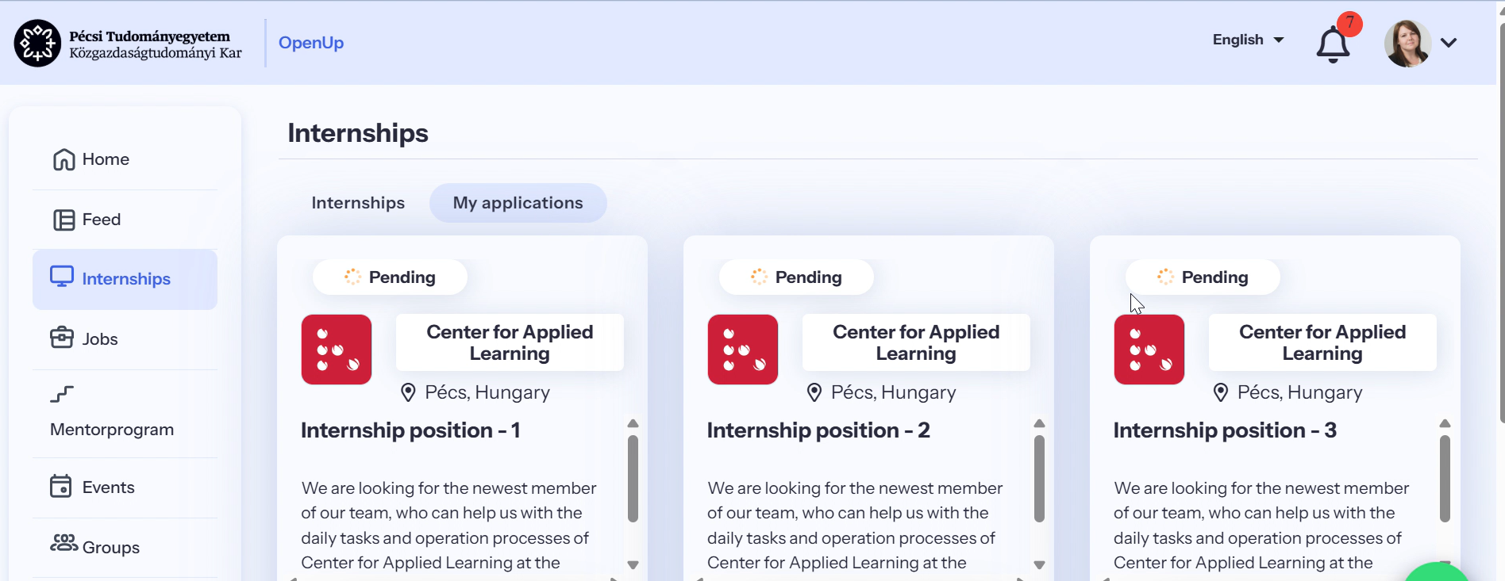
The “My Applications” menu shows the applications you have submitted during the current period. You may have up to three active applications at a time, with no order of preference among them.

Slide 8
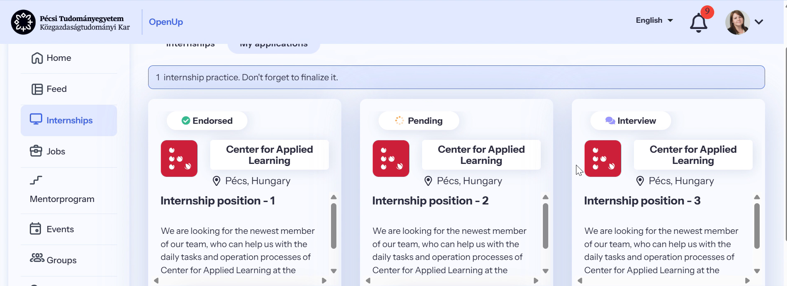
This menu also shows the status of your submitted applications. If an application is rejected or withdrawn, you may apply for another placement, but you can have no more than three active applications at the same time.

Slide 9
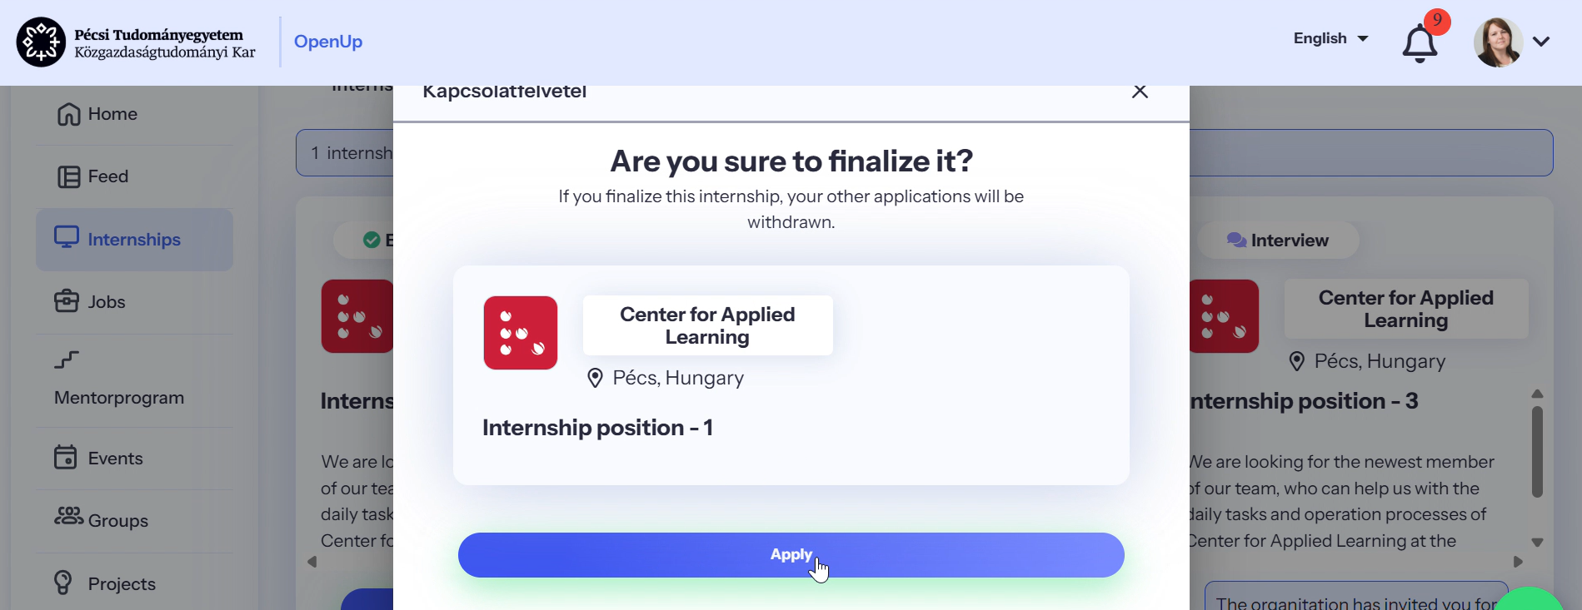
If a placement marked as “Accepted” by the company is suitable for you, you can confirm it by clicking “Apply” within the position. Once you finalize a placement, the system will automatically withdraw your other applications.

Slide 10
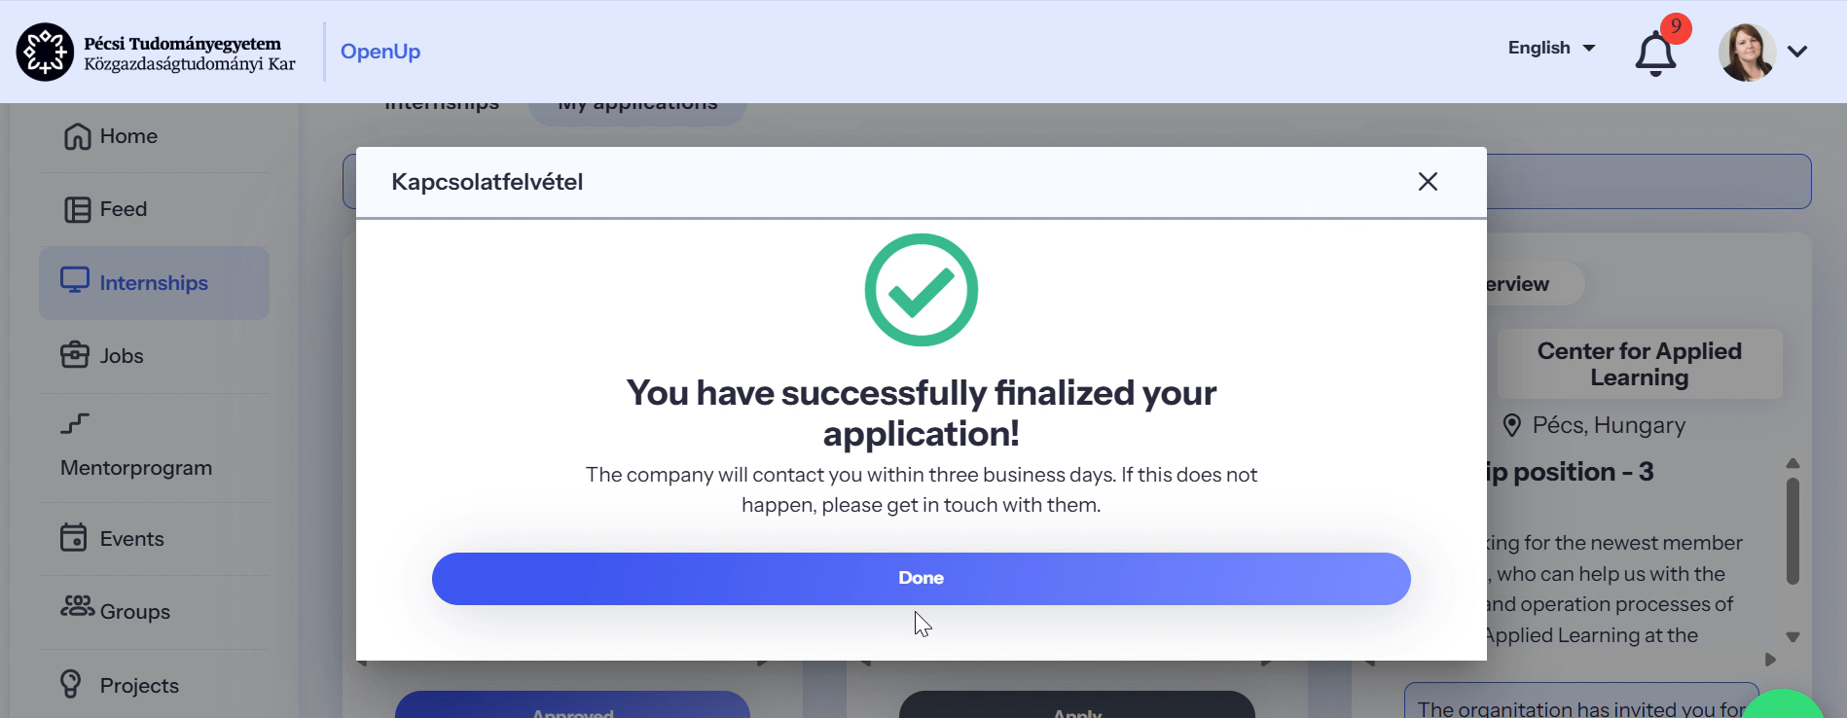
After finalizing, be sure to save the confirmation in the system by clicking “Done.”

Slide 11
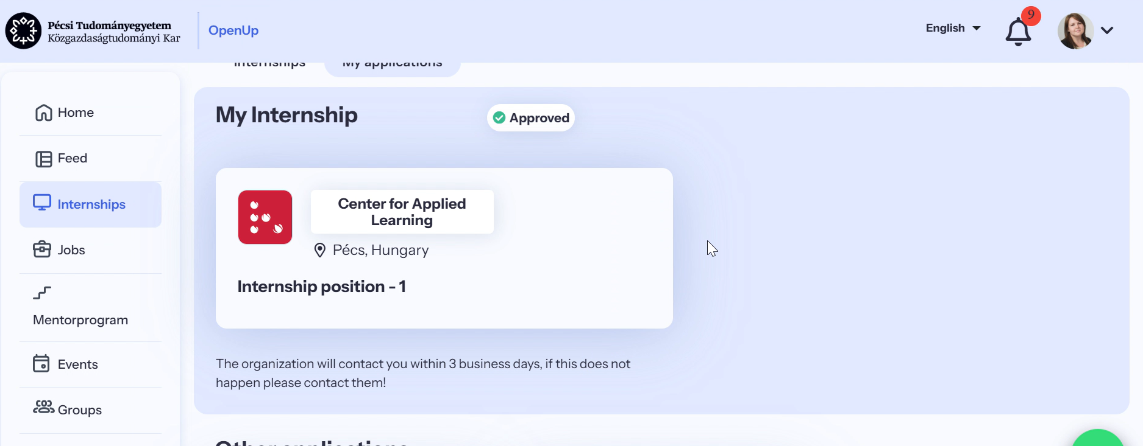
Once saved, the placement status will change to “Approved.” The company will then contact you within a few days regarding the necessary administrative steps.

Slide 12
Klaudia Rádóczy
radoczy.Klaudia@ktk.pte.hu
openup.pte.hu

