Slide 1
COMPULSORY INTERNSHIP
To be completed in the 2025/26 academic year

Slide 2
INTRODUCTION
Mr. Balázs KOVÁCS, Dr. Tutor, module leader
kovacsb@ktk.pte.hu
Ms. Noémi Iflinger responsible for Faculty offered places
iflinger.noemi@ktk.pte.hu
Ms. Judit TAKÁCS Student Affairs Officer of BSc in Business Administration and Management
takacs.judit@ktk.pte.hu
Study Department, counter 1
Ms. Gerda Dóczi Student Affairs Officer of BSc in Tourism and Catering doczi.gerda@ktk.pte.hu
Study Department, counter 2
Ms. Csenge TÓTH OpenUp technical supporter

Slide 3
CONDITIONS
Internship is compulsory to be completed in order to be able to
defend your thesis
acquire the Hungarian degree in the 7th / 8th (for TC) semester
Can be started
with completed 155 credits
after the 6th semester
after the 6th and 7th semester for TC students
Lenght: 12 weeks / 2* 12 weeks for TC
SH students must complete it in Hungary (learning agreement)

Slide 4
REGULATION, INFO, FORMS
Downloadable from the Faculty’s website:
https://ktk.pte.hu/en/students/studies/bachelor-programs/internship
By person:
Tutor
Study Department

Slide 5
GOALS AND TASKS
The taken position has to be professional and business-related.
Forms and contracts have to be submitted by the given deadlines.
You have to register yourself to „Szakmai gyakorlat” (Internship) module in NEPTUN in the 7th semester.
TC students need to register for Internship I for 20 credits in the 7th semester and Internship II for 30 credits in the 8th semester.
Internship module worths 20 credits and will be evaluated by your mentor at the company:
Mentor’s Evaluation form (to be submitted by a given deadline after the intership period)

Slide 6
SCHEDULE
Preparation
Orientation 6th.03.2025. 13:00. B314.
Register on OPENUP 3rd.03.2024- 2nd.05.2025.
Finalisation: 5th 05.2025.
https://www.facebook.com/openup.education/photos_albums.
Faculty offers (not too many therefore SH students enjoy priority)
OR
Finding a place
Accreditation and contract
Completion
Follow-up
Mentor’s evaluation submission

Slide 7
PROCESS
Finding a place
Accreditation
Forms and contracts
Register on OPENUP
Faculty offers
Internship
Mentor’s evaluation
Grade/credits

Slide 8
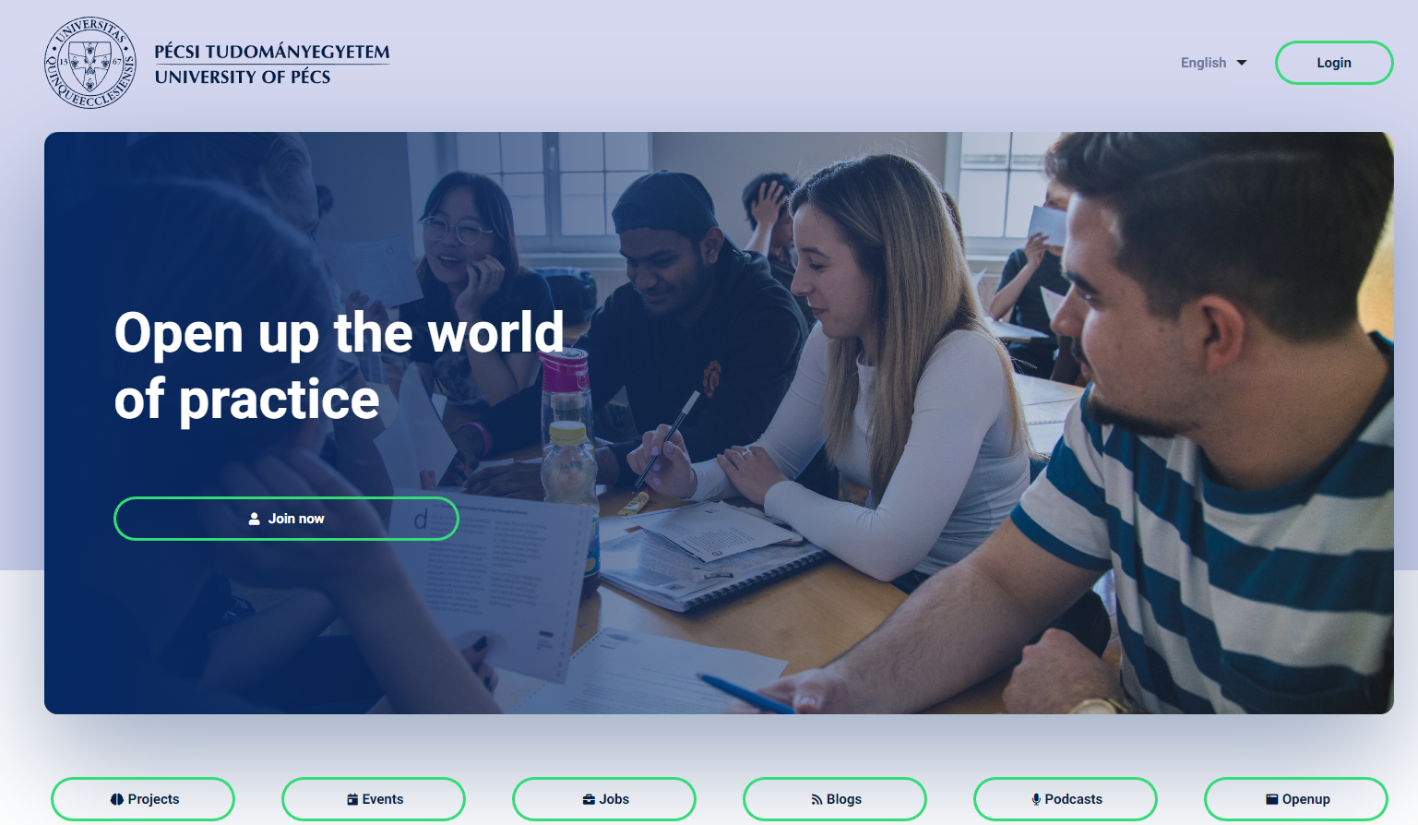
Internship application on Openup
Deadlines:
3 March – 5 May:
Register on Openup,
Fill out the profile,
Upload your CV,
Upload a professional profile picture and a cover photo
Apply for 3 positions and wait for the notification about being called for an interview or being hired
After being accepted on the surface, please make sure you accept only that company’s position that you truly want to go because after this action, there is no opportunity to change the decision, the contract process starts

Slide 9
ACCREDITATION PROCEDURE AND DEADLINES
Finding a place
Accreditation
Submission of accreditation form and Letter of Acceptance | 7th April 2025
Acceptance/refusal | 28th April 2025

Slide 10
FACULTY OFFERS AND DEADLINES
Register on OPENUP
Application for Faculty offers
Submisson of applications (OPENUP) | 3rd March – 5nd May 2025
Interviews | TBD
Decision | TBD

Slide 11
CONTRACTS AND DEADLINES
Finding a place
Accreditation
Contract – to be dealt with only in the case of accreditation. Faculty offer contracts are to be dealt with the managment.
Application for Faculty offers, interviews
Deadline of submisson |  | 12th May 2025

Slide 12
INTERNSHIP PERIOD
Internship
 | from | till
Internship | 9th June 2025 | 1st November 2025

Slide 13
EVALUATION
Mentor’s evaluation
Grade/credit
Submission of mentor’s evaluation | 14th November 2025
Grade record | 4th December 2025

Slide 14
WHO TO CONTACT IN CASE OF DIFFICULTIES DURING THE INTERNSHIP?
Professional, work-related problems: Balázs KOVÁCS, Dr.
Problems with faculty offered places: Noémi IFLINGER
Administrative issues: Judit TAKÁCS(BAM)
Gerda DÓCZI (TC)
OpenUp issues: Csenge TÓTH

Slide 15
QUESTIONS?

Slide 16
Thank you for your attention!

