Slide 1







COMPULSORY INTERNSHIP
To be completed in the 2026/27 academic year
11th March, 2026.

Slide 2
Introduction
Mr. Balázs KOVÁCS, Dr. Tutor, module leader e-mail: kovacsb@ktk.pte.hu
Mr. Dániel HORVÁTH Responsible for Faculty offered places e-mail: horvath.daniel@ktk.pte.hu
Ms. Judit TAKÁCS Student Affairs Officer of BSc in Business Administration and Management
takacs.judit@ktk.pte.hu Study Department, counter 1
Ms. Gerda DÓCZI Student Affairs Officer of BSc in Tourism and Catering doczi.gerda@ktk.pte.hu Study Department, counter 2
Ms. Klaudia RÁDÓCZY OpenUp technical supporter e-mail: radoczy.klaudia@ktk.pte.hu

Slide 3
Conditions
An internship is compulsory to be completed in order to be able to
  defend your thesis
  acquire the Hungarian degree in the 7th / 8th (for TC) semester
  Can be started
  with completed 155 credits
  after the 6th semester
  after the 6th and 7th semester for TC students
Length: 12 weeks / 2* 12 weeks for TC
SH students must complete it in Hungary or remotely (learning agreement)

Slide 4
Regulation, Info, Forms
Downloadable from the Faculty’s website:
https://ktk.pte.hu/en/students/studies/bachelor-programs/internship
By person:
Tutor
Study Department

Slide 5
Goals and Tasks
The taken position has to be professional and business-related.
Forms and contracts have to be submitted by the given deadlines.
You have to register yourself to „Szakmai gyakorlat” (Internship) module in NEPTUN in the 7th semester.
TC students need to register for Internship I for 20 credits in the 7th semester and Internship II for 30 credits in the 8th semester.
Internship module worths 20 credits and will be evaluated by your mentor at the company:
Mentor’s Evaluation form (to be submitted by a given deadline after the intership period)

Slide 6
Schedule
Preparation
Orientation 11th.03.2026. 14:30. B025.
Register on OPENUP 10th.03.2026- 12th.05.2026. (interviews, feedbacks)
Finalisation: 15th 05.2026.
https://openup.pte.hu/welcome
Faculty offers (not too many, therefore SH students enjoy priority)
  OR
Finding a place
  Accreditation and contract
Completion
Follow-up
  Mentor’s evaluation submission

Slide 7
Process
Finding a place
Accreditation
Forms and contracts
Register on OPENUP
Faculty offers
Internship
Mentor’s evaluation
Grade/credits

Slide 8
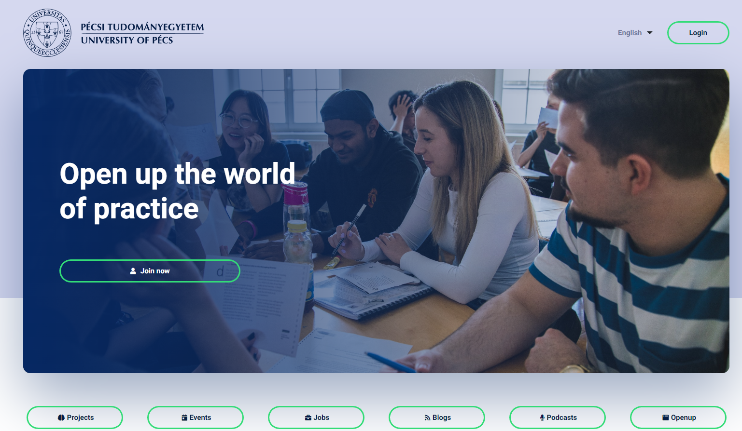
Internship application on Openup
Deadlines:
10 March – 15 May:
Register on Openup,
Fill out the profile,
Upload your CV,
Upload a professional profile picture and a cover photo
Apply for 3 positions and wait for the notification about being called for an interview or being hired
After being accepted on the surface, please make sure you accept only that company’s position that you truly want to go because after this action, there is no opportunity to change the decision, the contract process starts

Slide 9
Accreditation procedure and deadlines
Finding a place
Accreditation
Submission of accreditation form and Letter of Acceptance | 16th April 2026
Acceptance/refusal | 27th April 2026
Submission of Cooperation agreement | 11th May 2026

Slide 10
Faculty offers and deadlines
Register on OPENUP
Application for Faculty offers
Submisson of applications (OPENUP) | 10th March – 15th May 2026
Interviews | 10th of March – 24th of April
Decision | 27th April – 12nd May
Finalization | 15th of May

Slide 11
Contracts and deadlines
Finding a place
Accreditation
Contract – to be dealt with only in the case of accreditation. Faculty offer contracts are to be dealt with the managment.
Application for Faculty offers, interviews
Deadline of submisson |  | 11th May 2026

Slide 12
Internship period
Internship
 | from | till
Internship | 9th June 2026 | 2nd November 2026

Slide 13
Evaluation
Mentor’s evaluation
Grade/credit
Submission of mentor’s evaluation | 9th November 2026
Grade record | 2nd December 2026

Slide 14
Who to contact in case of difficulties during the internship
Professional, work-related problems: Balázs KOVÁCS, Dr.
Problems with faculty offered places: Dániel HORVÁTH
Administrative issues: Judit TAKÁCS(BAM)
Gerda DÓCZI (TC)
OpenUp issues: Klaudia RÁDÓCZY

Slide 15
Questions?

Slide 16

Thank you for your attention!
Előadó neve
Munkakör
Munkahely
Dátum

Slide 17


